Slide 1
Writing your Literature Review
Robert Crawford
r.crawford@sheffield.ac.uk

Slide 2

Attendance
Please complete the form linked in the chat box

Slide 3
Lesson Outline
By the end of this session you will have…
Become familiar with the features of a good literature review
Considered the process of writing a literature review

Slide 4
What is a Literature Review?
A literature review is the section of a paper or dissertation in which you discuss previous research related to your topic.

Slide 5

Why is it important to undertake a literature review?
Your research is a small piece in a complicated jigsaw puzzle; it does not stand alone.
Your reader needs to know about the whole jigsaw puzzle (the bigger picture)

Slide 6
What you should do in a literature review?
Identify general trends and positions in your research area.
Explain the relation of your own research to the wider field.
Compare and contrast the papers you have read.
Identify a research gap in the area.
Identify theories and approaches that are useful for your research.
Justify your research - explain why it is worth doing.

Slide 7
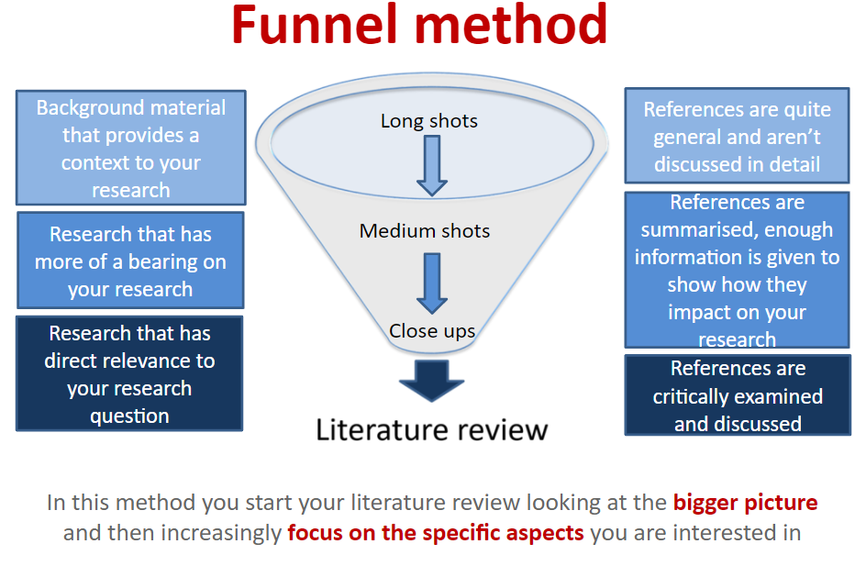

Slide 8
Purpose of a literature review Task 1
What is the purpose of a Literature Review? Complete the sentences with the words in the box.
It provides a ______________ background.
It gives an overview of the current ___________ in which your research is situated by referring to contemporary debates, issues and ____________ in the field.
It includes a _____________ of the relevant theories and concepts which _____________ your research.
It introduces relevant terminology and provides ____________ to clarify how terms are being used in the context of your own work.
It describes related ______________ in the field and shows how your ____________ extends or challenges a gap in work in the field.
It provides supporting _______________ for a practical problem or _____________ which your research is addressing, thereby underlining its significance.
issue historical work questions underpin
definitions evidence context discussion research
(Adapted from Ridley, D. (2009) The Literature Review: a step-by-step guide for students. Sage: London)

Slide 9
Purpose of a literature review Task 1 Answers
What is the purpose of a Literature Review? Complete the sentences with the words in the box.
It provides a historical background.
It gives an overview of the current ___________ in which your research is situated by referring to contemporary debates, issues and ____________ in the field.
It includes a _____________ of the relevant theories and concepts which _____________ your research.
It introduces relevant terminology and provides ____________ to clarify how terms are being used in the context of your own work.
It describes related ______________ in the field and shows how your ____________ extends or challenges a gap in work in the field.
It provides supporting _______________ for a practical problem or _____________ which your research is addressing, thereby underlining its significance.
issue historical work questions underpin
definitions evidence context discussion research

Slide 10
Purpose of a literature review Task 1 Answers
What is the purpose of a Literature Review? Complete the sentences with the words in the box.
It provides a historical background.
It gives an overview of the current context in which your research is situated by referring to contemporary debates, issues and questions in the field.
It includes a _____________ of the relevant theories and concepts which _____________ your research.
It introduces relevant terminology and provides ____________ to clarify how terms are being used in the context of your own work.
It describes related ______________ in the field and shows how your ____________ extends or challenges a gap in work in the field.
It provides supporting _______________ for a practical problem or _____________ which your research is addressing, thereby underlining its significance.
issue historical work questions underpin
definitions evidence context discussion research

Slide 11
Purpose of a literature review Task 1 Answers
What is the purpose of a Literature Review? Complete the sentences with the words in the box.
It provides a historical background.
It gives an overview of the current context in which your research is situated by referring to contemporary debates, issues and questions in the field.
It includes a discussion of the relevant theories and concepts which underpin your research.
It introduces relevant terminology and provides ____________ to clarify how terms are being used in the context of your own work.
It describes related ______________ in the field and shows how your ____________ extends or challenges a gap in work in the field.
It provides supporting _______________ for a practical problem or _____________ which your research is addressing, thereby underlining its significance.
issue historical work questions underpin
definitions evidence context discussion research

Slide 12
Purpose of a literature review Task 1 Answers
What is the purpose of a Literature Review? Complete the sentences with the words in the box.
It provides a historical background.
It gives an overview of the current context in which your research is situated by referring to contemporary debates, issues and questions in the field.
It includes a discussion of the relevant theories and concepts which underpin your research.
It introduces relevant terminology and provides definitions to clarify how terms are being used in the context of your own work.
It describes related ______________ in the field and shows how your ____________ extends or challenges a gap in work in the field.
It provides supporting _______________ for a practical problem or _____________ which your research is addressing, thereby underlining its significance.
issue historical work questions underpin
definitions evidence context discussion research

Slide 13
Purpose of a literature review Task 1 Answers
What is the purpose of a Literature Review? Complete the sentences with the words in the box.
It provides a historical background.
It gives an overview of the current context in which your research is situated by referring to contemporary debates, issues and questions in the field.
It includes a discussion of the relevant theories and concepts which underpin your research.
It introduces relevant terminology and provides definitions to clarify how terms are being used in the context of your own work.
It describes related research in the field and shows how your work extends or challenges a gap in work in the field.
It provides supporting _______________ for a practical problem or _____________ which your research is addressing, thereby underlining its significance.
issue historical work questions underpin
definitions evidence context discussion research

Slide 14
Purpose of a literature review Task 1 Answers
What is the purpose of a Literature Review? Complete the sentences with the words in the box.
It provides a historical background.
It gives an overview of the current context in which your research is situated by referring to contemporary debates, issues and questions in the field.
It includes a discussion of the relevant theories and concepts which underpin your research.
It introduces relevant terminology and provides definitions to clarify how terms are being used in the context of your own work.
It describes related research in the field and shows how your work extends or challenges a gap in work in the field.
It provides supporting evidence for a practical problem or issue which your research is addressing, thereby underlining its significance.
issue historical work questions underpin
definitions evidence context discussion research

Slide 15
Literature review: true or false?
You need to describe all the research related to your topic.
You need to use one paragraph to describe each source.
You should take a critical approach to the literature that you discuss.
Your literature review should have a short introduction.
You should synthesise findings from different sources.
You should include a short conclusion.
You should correctly reference all your sources.
All information from sources should be paraphrased.

Slide 16
How can you identify a gap in the research?

Slide 17
Identifying a gap in the research
Read articles related to your topic.
What recommendations do they make for future research in the conclusion?
What limitations in their own research do they mention?

Slide 18
Think carefully about the language you use
The language you use can show you are adopting a critical attitude to your sources. It shows that you are considering carefully the evidence presented in the sources.
This shows confidence:
‘There is clearly a link…’
This shows caution:
‘This suggests a link…’

Slide 19
Critical verbs in action
The three sentences below demonstrate how verbs can be used to show critical thinking in your writing.
Smith (2005) states that theory X is valuable in practice. (This sentence is neutral and descriptive.)
Smith (2005) claims that theory X is valuable in practice; however, he neglects to take account of factor Y. (Identifies weakness in argument)
Smith (2005) clearly demonstrates that theory X is valuable in practice by drawing a link between Y and Z. (Positive evaluation of argument)

Slide 20
Highlighting inadequacies of previous studies
Previous studies of X have not dealt with …
Researchers have not treated X in much detail.
Such expositions are unsatisfactory because they …
Most studies in the field of X have only focused on …
Such approaches, however, have failed to address …
Previous published studies are limited to local surveys.
Half of the studies evaluated failed to specify whether …
The research to date has tended to focus on X rather than Y.
https://www.phrasebank.manchester.ac.uk/

Slide 21
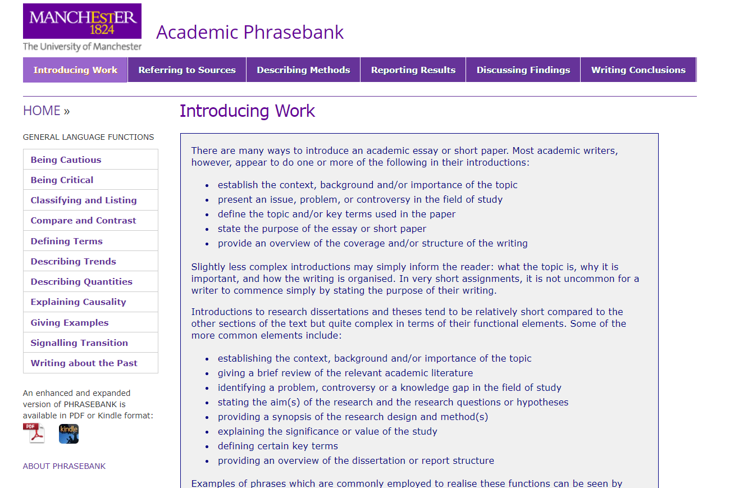

Slide 22
A good literature review is synthetic: general trends and positions in your research area should be identified, and the papers you cite should be compared and contrasted.

Slide 23
How to approach writing Literature Review
Analysing
Summarising
Evaluating

Slide 24
How to approach writing Literature Review
Analysing - what do you need to do?
Show a questioning & searching approach when reading
Identify what is important
Look for explanations, relationships, comparisons, predictions, generalisations & theories
Identify what is not in the source text - bias?

Slide 25
How to approach writing Literature Review
Summarising - what do you need to do?
Report ideas from source material briefly
Choose what is relevant and important for your writing
Integrate ideas from source material into what you wish to say

Slide 26
How to approach writing Literature Review
Evaluating - what do you need to do?
Make judgements about the source materials
Identify underlying assumptions, attitudes and opinions in source material
Evaluate arguments in source material and identify how effectively they are supported
Identify gaps in source material
Include your comment as well as summaries of ideas from source material - it is your evaluation

Slide 27
Look at the extract from a student’s literature review. In which sentence does the student…
Compare results obtained by previous researchers?
Identify a gap in the research?
Explain why the research is important?
Does it use the funnel method of organising a literature review?
What critical verbs does the student use to comment on the evidence?
https://docs.google.com/document/d/1deWwPZQkGJ1ui0uP0zj5O-Fn-FAq4qFPOKhtMCAjq78/edit?usp=sharing

Slide 28
The whole process of reviewing includes: searching for literature; sorting and prioritising the retrieved literature; evaluative reading of papers; comparison across studies; organising the content; writing the review.
You should extract key points by comparing and contrasting ACROSS studies, instead of reading one paper after another. Take notes from your sources as you read them.

Slide 29
Look at the example of notes taken by a student for a literature review.
https://drive.google.com/file/d/16X_NFtWnSziYiPew_Y9aiKKIKqknEu4q/view?usp=sharing
What do you think of this way of making notes? What are its advantages and disadvantages?

Slide 30
Active note-taking means:
thinking critically about what you are reading
looking for answers to any questions you may have about the topic
looking for connections within the topic you're studying, and to other topics on your course
writing notes mostly in your own words - your own explanation of what something says or means - helps avoid unintentional plagiarism
provides a personal record of what you've learnt (more useful than your lecturer's or friends' notes) and records your questions and ideas

Slide 31
The conclusion of the review needs to sum up the main findings of your research into the literature. The findings are related to the aims of your proposed research. The reader is thus provided with a coherent background to the current study.

